Slide 1
MODULE 4: CLOUD SECURITY
By – Shalu Chopra
Information Technology Department,
VESIT.

Slide 2
CLOUD SECURITY
What is Cloud Computing ?

Slide 3
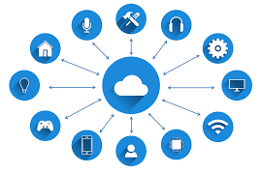
CLOUD COMPUTING
Cloud computing is the on-demand availability of computer system resources, especially data storage and computing power, without direct active management by the user.

Slide 4
Cloud computing is the on-demand delivery of IT resources over the Internet with pay-as-you-go pricing. Instead of buying, owning, and maintaining physical data centers and servers, you can access technology services, such as computing power, storage, and databases, on an as-needed basis from a cloud provider like Amazon Web Services (AWS).

Slide 5
Rather than keeping files on a proprietary hard drive or local storage device, cloud-based storage makes it possible to save them to a remote database. As long as an electronic device has access to the web, it has access to the data and the software programs to run it.
Cloud computing is a popular option for people and businesses for a number of reasons including cost savings, increased productivity, speed and efficiency, performance, and security.

Slide 6
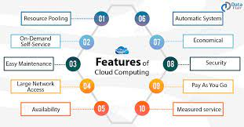

Slide 7
Types of Cloud Services
Regardless of the kind of service, cloud computing services provide users with a series of functions including:
Email
Storage, backup, and data retrieval
Creating and testing apps
Analyzing data
Audio and video streaming
Delivering software on demand

Slide 8
What's Driving Cloud Computing?
Thought leaders
Amazon, Google, Microsoft and many
The economy
Capex Vs Opex
The Feds
Govt, Enterprise, Innovators (startups)

Slide 9
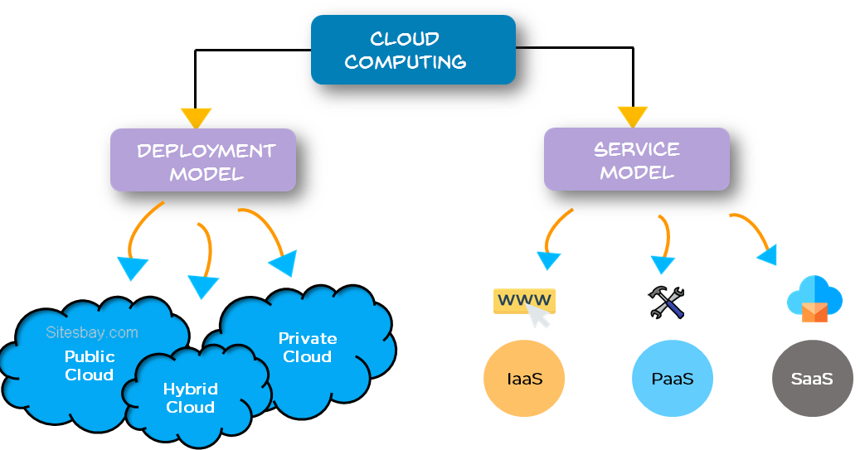
CLOUD COMPUTING MODELS

Slide 10
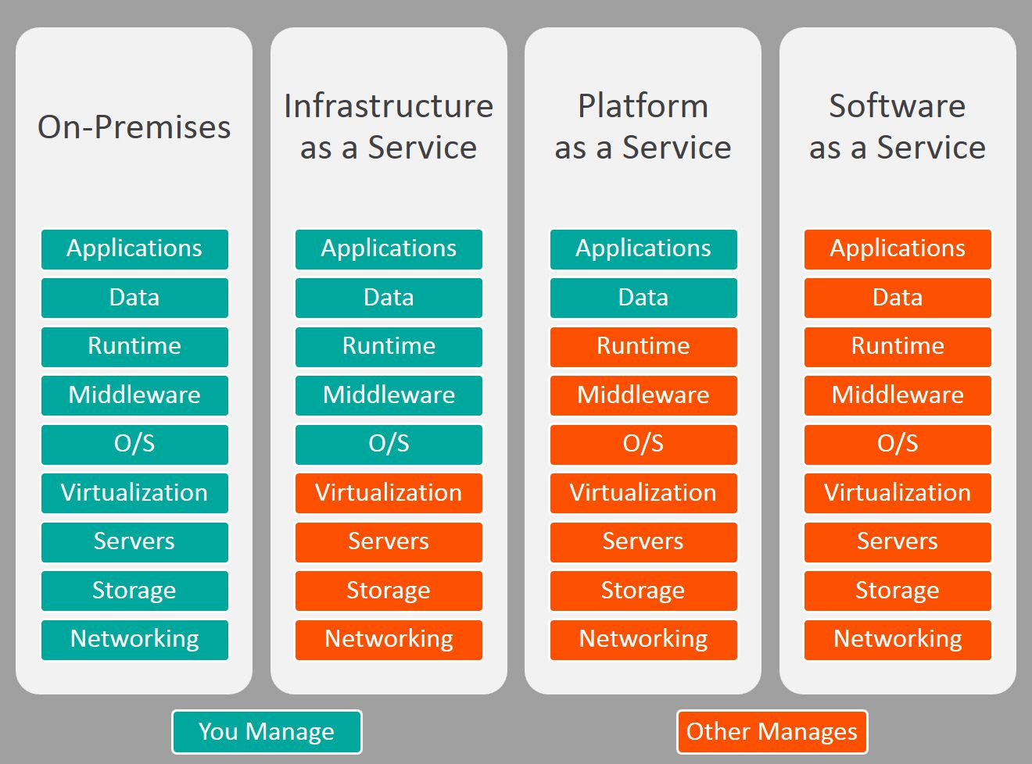
IaaS, PaaS and SaaS
Kit/ Studios

Slide 11
SaaS: Software as a Service
Software as a Service, also known as cloud application services, represents the most commonly utilized option for businesses in the cloud market.
SaaS provides us a complete product that is run and managed by the service provider. In most cases, people referring to SaaS are referring to end-user applications (such as web-based email). With a SaaS offering, we don’t have to think about how the service is maintained or how the underlying infrastructure is managed. We only need to think about how we will use that particular software.

Slide 12
PaaS: Platform as a Service
PaaS removes the need for us to manage underlying infrastructure (usually hardware and operating systems), and allows us to focus on the deployment and management of your applications.
This helps us to be more efficient as we don’t need to worry about resource procurement, capacity planning, software maintenance, patching, or any of the other undifferentiated heavy lifting involved in running your application.

Slide 13
IaaS: Infrastructure as a Service
IaaS contains the basic building blocks for cloud IT.
IaaS is fully self-service for accessing and monitoring computers, networking, storage, and other services.
IaaS allows businesses to purchase resources on-demand and as-needed instead of having to buy hardware outright.
It typically provides access to networking features, computers (virtual or on dedicated hardware), and data storage space.
IaaS gives the highest level of flexibility and management control over your IT resources. It is most similar to the existing IT resources with which many IT departments and developers are familiar.

Slide 14
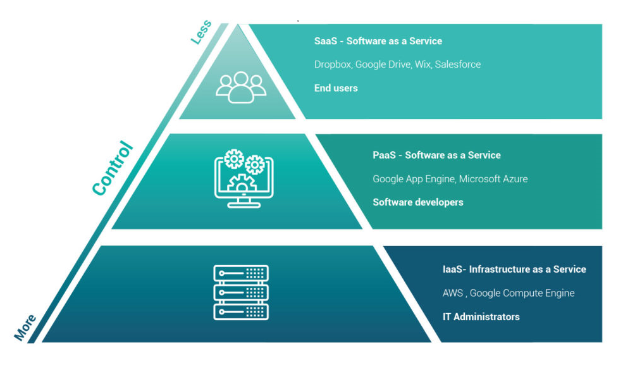
CLOUD COMPUTING MODELS
CLOUD COMPUTING SERVICE MODELS

Slide 15
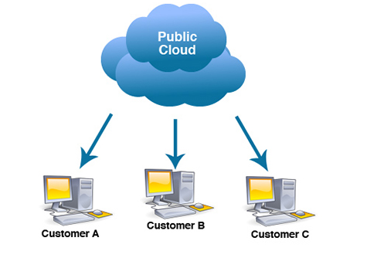
PUBLIC CLOUD
A public cloud is a platform that uses the standard cloud computing model to make resources -- such as virtual machines, applications or storage available to users remotely.

Slide 16
PUBLIC CLOUD
Public cloud services may be free or offered through a variety of subscription or on-demand pricing schemes, including a pay-per-usage model.
The main benefits of the public cloud are as follows:
a reduced need for organizations to invest in and maintain their own on-premises IT resources;
scalability to meet workload and user demands; and
fewer wasted resources because customers only pay for what they use.

Slide 17
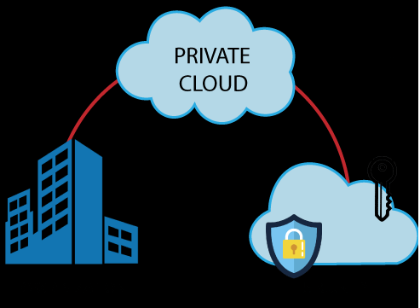
PRIVATE CLOUD
Private cloud is a type of cloud computing that delivers similar advantages to public cloud, including scalability and self-service, but through a proprietary architecture.

Slide 18
PRIVATE CLOUD
Unlike public clouds, which deliver services to multiple organizations, a private cloud is dedicated to the needs and goals of a single organization.
The advantages of having a Private Cloud are:
More Secured
All time availability

Slide 19
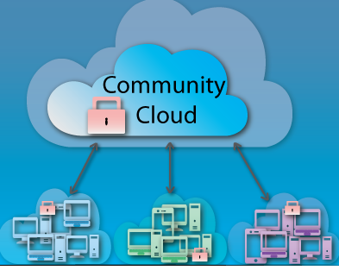
COMMUNITY CLOUD
Community cloud is a cloud infrastructure that allows systems and services to be accessible by a group of several organizations to share the information.

Slide 20
COMMUNITY CLOUD
It is owned, managed, and operated by one or more organizations in the community, a third party, or a combination of them.
There are the following advantages of Community Cloud –
Cost Effective
Flexible and Scalable
Security
Sharing Infrastructure

Slide 21
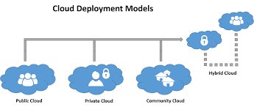

Slide 22
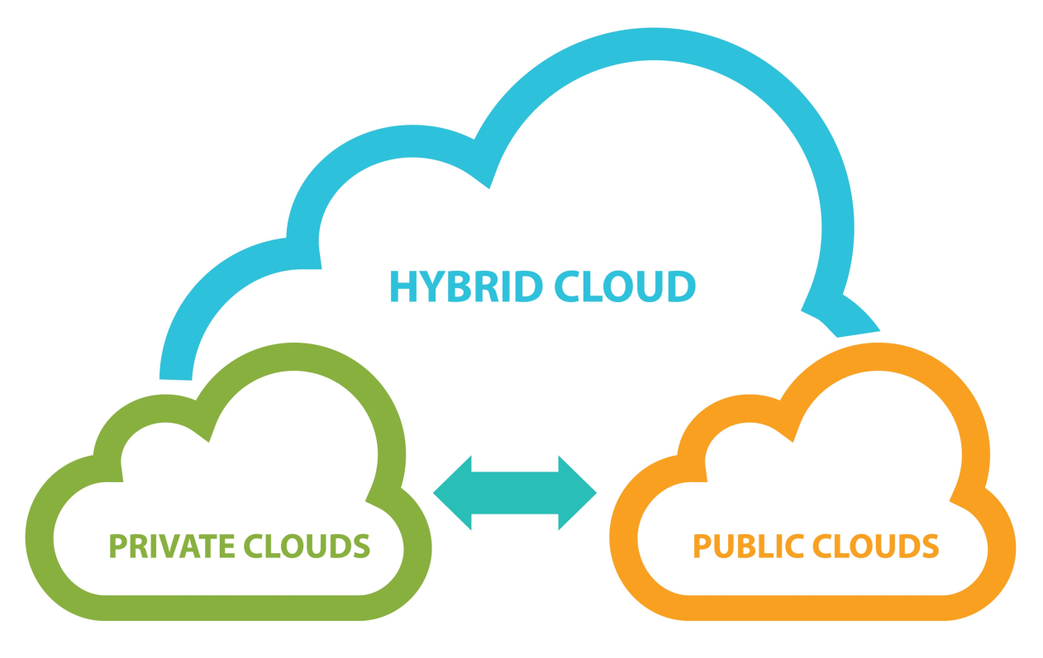
HYBRID CLOUD
A hybrid cloud is a computing environment which combines a public cloud and a private cloud by allowing data and applications to be shared between them.

Slide 23
HYBRID CLOUD
Organisations gain the flexibility and computing power of the public cloud for basic and non-sensitive computing tasks, while keeping business-critical applications and data on-premises, safely behind a company’s private firewall.
Hybrid clouds have a number of uses. An organization may use their private cloud for some services and their public cloud for others, or they may use the public cloud as backup for their private cloud.
They can also use the public cloud to handle periods of high demand, while keeping most operations within their private cloud.

Slide 24
CLOUD COMPUTING ENTITIES
The essential components of the NIST reference model include:
Cloud Customer
Cloud Provider
Cloud Auditor
Cloud Carrier (Service Brokers and Resellers)

Slide 25
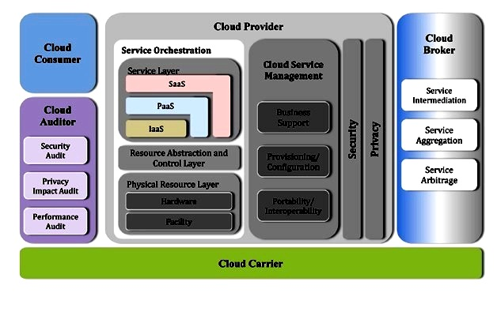

Slide 26
CLOUD COMPUTING ENTITIES
Cloud Service Providers: A group or object that delivers cloud services to cloud consumers or end-users.
Cloud Carrier: The mediator who provides offers connectivity and transport of cloud services within cloud service providers and cloud consumers
Cloud Broker : An organization or a unit that manages the performance, use, and delivery of cloud services by enhancing specific capability and offers value-added services to cloud consumers. It combines and integrates various services into one or more new services.
Cloud Auditor: An entity that can conduct independent assessment of cloud services, security, performance
Security Audit, Performance Audit
Cloud Consumer: A cloud consumer is the end-user who browses or utilizes the services provided by Cloud Service Providers (CSP), sets up service contracts with the cloud provider.

Slide 27
Cloud Computing Challenges

Slide 28
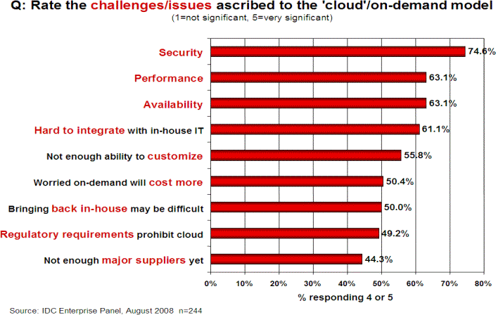
Cloud Computing Challenges
Source: http://www.csrc.nist.gov/groups/SNS/cloud-computing/cloud-computing-v26.ppt
at slide 17
OWASP
9

Slide 29
What is Cloud computing Security?
OWASP

Slide 30
In Some Ways, "Cloud Computing Security" Is No Different Than "Regular Security"
OWASP
13

Slide 31
SECURITY RISKS IN CLOUD COMPUTING
Data Loss
Interference of Hackers and Insecure API’s –
Data breaches
Compliance Violations & regulatory actions
Hacked Interfaces
Malware Injections
Identity management & weak authentication
Abuse and nefarious use of Cloud Services

Slide 32
SECURITY RISKS IN CLOUD COMPUTING
Data Loss – most faced issue.. also known as Data Leakage.
As we know that our sensitive data is in the hands of Somebody else, and we don’t have full control over our database. So, if the security of cloud service is to break by hackers then it may be possible that hackers will get access to our sensitive data or personal files.

Slide 33
SECURITY RISKS IN CLOUD COMPUTING
Interference of Hackers and Insecure API’s - cloud and its services means – internet.
Also, the easiest way to communicate with Cloud is using API.
So it is important to protect the Interface’s and API’s which are used by an external user.
In cloud computing, few services are available in the public domain which are the vulnerable part of Cloud Computing because it may be possible that these services are accessed by some third parties. So, the service hackers can easily hack or harm our data with the help of these services.

Slide 34
SECURITY RISKS IN CLOUD COMPUTING
User Account Hijacking –
Account Hijacking is the most serious security issue in Cloud Computing. If somehow the Account of User or an Organization is hijacked by a hacker then the hacker has full authority to perform Unauthorized Activities.

Slide 35
SECURITY RISKS IN CLOUD COMPUTING
Changing Service Provider – Vendor lock-In is also an important Security issue in Cloud Computing.
Many organizations will face different problems while shifting from one vendor to another.
For example, If An Organization wants to shift from AWS Cloud to Google Cloud Services then they face various problems like shifting of all data, also both cloud services have different techniques and functions, and also the charges may be different.
Lack of skill
How to use need an extra feature etc.

Slide 36
SECURITY RISKS IN CLOUD COMPUTING
Denial of Service (DoS) attack –
This type of attack occurs when the system receives too much traffic. Mostly DoS attacks occur in large organizations such as the banking sector, government sector, etc. When a DoS attack occurs, data is lost. So, in order to recover data, it requires a great amount of money as well as time to handle it.
Shared Resources -
Cloud computing relies on a shared infrastructure. If one customer’s data or applications are compromised, it may potentially affect other customers sharing the same resources, leading to a breach of confidentiality or integrity.

Slide 37
SECURITY RISKS IN CLOUD COMPUTING
Compliance and Legal Issues -
Different industries and regions have specific regulatory requirements for data handling and storage. Ensuring compliance with these regulations can be challenging when data is stored in a cloud environment that may span multiple jurisdictions.
Data Encryption -
While data in transit is often encrypted, data at rest can be susceptible to breaches. It’s crucial to ensure that data stored in the cloud is properly encrypted to prevent unauthorized access.

Slide 38
SECURITY RISKS IN CLOUD COMPUTING
Insider Threats -
Employees or service providers with access to cloud systems may misuse their privileges, intentionally or unintentionally causing data breaches. Proper access controls and monitoring are essential to mitigate these threats.
Data Location and Sovereignty -
Knowing where your data physically resides is important for compliance and security. Some cloud providers store data in multiple locations globally, and this may raise concerns about data sovereignty and who has access to it.
Loss of Control -
When using a cloud service, you are entrusting a third party with your data and applications. This loss of direct control can lead to concerns about data ownership, access, and availability.

Slide 39
SECURITY RISKS IN CLOUD COMPUTING
Incident Response and Forensics -
Investigating security incidents in a cloud environment can be complex. Understanding what happened and who is responsible can be challenging due to the distributed and shared nature of cloud services.
Data Backup and Recovery –
Relying on cloud providers for data backup and recovery can be risky. It’s essential to have a robust backup and recovery strategy in place to ensure data availability in case of outages or data loss.
Vendor Security Practices -
The security practices of cloud service providers can vary. It’s essential to thoroughly assess the security measures and certifications of a chosen provider to ensure they meet your organization’s requirements.
~~Firewalls/ Virtualization

Slide 40
Issues with the Choice of Cloud Provider
 It may seem daunting at first to realize that your application depends (critically!) on the trustworthiness of your cloud providers, but this is not really anything new -- today, even if you're not using the cloud, you already rely on and trust:
-- network service providers,
-- hardware vendors,
-- software vendors,
-- service providers,
-- data sources, etc.
Your cloud provider will be just one more entity on that list.

Slide 41
Issues with Cloud Provider Location
 Location of the Cloud with respect to storage & computing
Due to competition of Cloud Pricing, they always look for low cost data centers
Thus, your cloud provider could be working someplace you may never have heard of, such as The Dalles, Oregon, where power is cheap and fiber is plentiful, or just as easily someplace overseas.
laws and policies of that jurisdiction. Are you comfortable
with that framework?
 Are you also confident that international connectivity will remain up and uncongested? Can you live with the latencies involved?

Slide 42
COUNTERMEASURES
Data Encryption
Use of Antivirus
Strong Authentication
Check Security Measures
Define Policies Before Sharing Data
Avoid Saving Crucial or Sensitive Data on Cloud

Slide 43
DATA PROTECTION IN CLOUD
Data protection is a crucial security issue for most organizations.
Before moving into the cloud, cloud users need to clearly identify data objects to be protected and classify data based on their implication on security, and then define the security policy for data protection as well as the policy enforcement mechanisms.
The basic security services for information security include assurance of data Confidentiality, Integrity, and Availability (CIA).
In Cloud Computing, the issue of data security becomes more complicated because of the intrinsic cloud characteristics.

Slide 44
DATA PROTECTION IN CLOUD
A suit of security services would be in place which we can identify as follows:
Data confidentiality assurance
Data integrity protection
Guarantee of data availability
Secure data access
Regulations and compliances
Service audition

Slide 45
Cloud Identity and Access Management
Cloud Identity and Access Management (IAM) lets administrators authorize who can take action on specific resources, giving you full control and visibility to manage Google Cloud resources centrally.
For enterprises with complex organizational structures, hundreds of workgroups, and many projects, Cloud IAM provides a unified view into security policy across your entire organization, with built-in auditing to ease compliance processes.

Slide 46
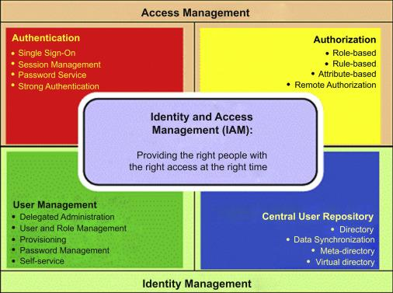
Cloud Identity and Access Management

Slide 47
Cloud Identity and Access Management
Features of Cloud IAM are:
Single access control interface
Fine-grained control
Automated access control recommendations
Context-aware access
Flexible roles
Built-in audit trail

Slide 48
Cloud Identity and Access Management
IAM from major Cloud Providers are:
Amazon
Google
IBM

Slide 49
CLOUD SECURITY AS A SERVICES
Security as a service (SECaaS or SaaS)
is a business model in which a service provider integrates their security services into a corporate infrastructure on a subscription basis. This is called as SECaaS "software as a service“
The companies don’t need on-premises hardware, avoiding substantial capital outlays. These security services typically embody
Authentication, Aantivirus, anti-malware/spyware, Intrusion detection, penetration testing, and security event management, among others.

Slide 50
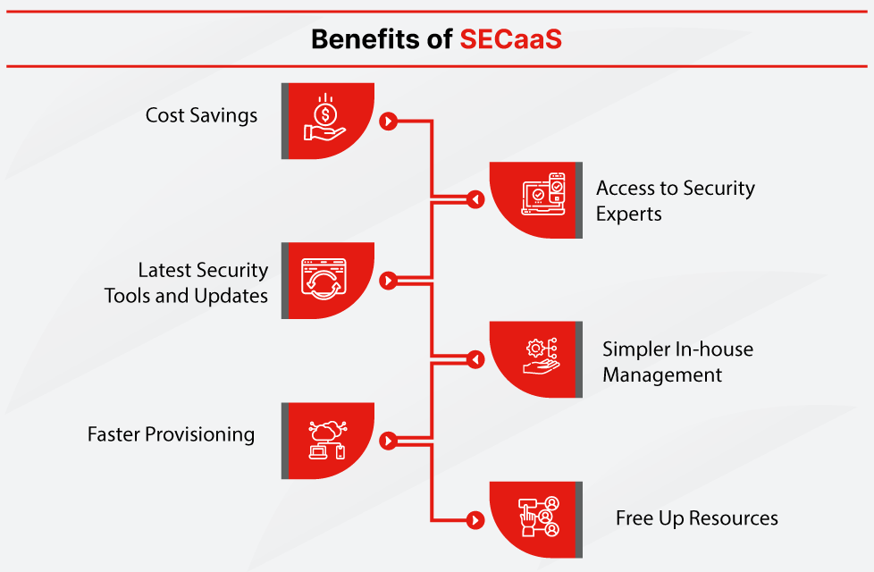
CLOUD SECURITY AS A SERVICE

Slide 51
Some examples of SECaaS services include:
Data loss prevention (DLP)
Continuous monitoring
Disaster recovery
Business continuity
Identity and access management (IAM)
Encryption
Email security
Security assessment
Network security
Intrusion management
Web security
Vulnerability scanning
Security information and event management (SIEM)

Slide 52
How to Choose a Security as a Service Provider
Handing over the security of your most critical and sensitive business assets is a massive undertaking.
Availability - Your network must be available 24 hours a day and so should your SECaaS provider. Vet out the vendor’s SLA to make sure they can provide the uptime your business needs and to know how outages are handled.
Fast Response Times - Fast response times are just as important as availability. Look for providers that offer guaranteed response times for incidents, queries and system updates.
Disaster Recovery Planning - Your provider should work closely with you to understand the vulnerabilities of your infrastructure and the external threats that are most likely to cause the most damage. From vandalism to weather disasters, your provider should ensure your business can recover quickly from these disruptive events.
Vendor Partnerships - A SECaaS provider is only ever as good as the vendors that have forged partnerships with. Look for providers that work with best in class security solution vendors and who also have the expertise to support these solutions.

Slide 53
THANK YOU

